Slide 1
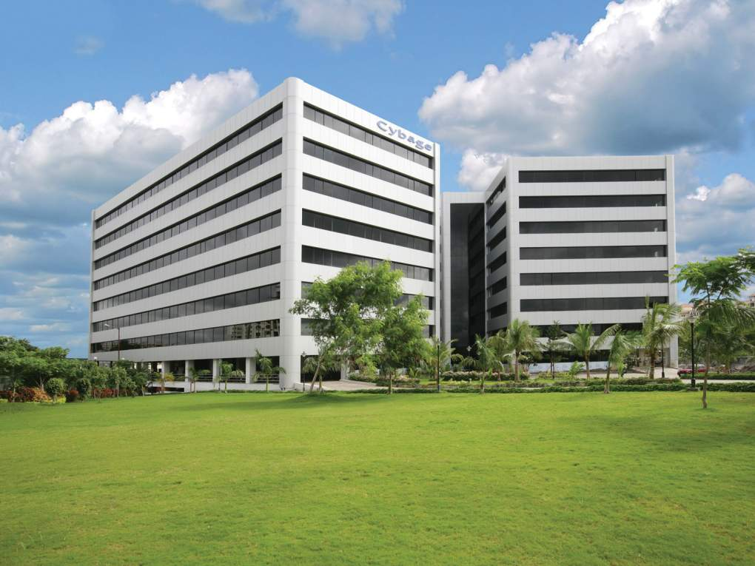

CYBAGE : ALM - DevOps

Slide 2
Agenda
Industry state
Impact and future of ALM and DevOps
How ALM-DevOps helps Business
Cybage ALM - DevOps Facts
Cybage - Capability & Experience
ALM - DevOps Maturity Model
Showcase
Cybage Services (ALM & DevOps)
ALM Tools Stack ( LT & Microsoft)
DevOps Ecosystem ( LT & Microsoft)
Docker Ecosystem for DevOps
Cybage Approach for Implementation
2

Slide 3
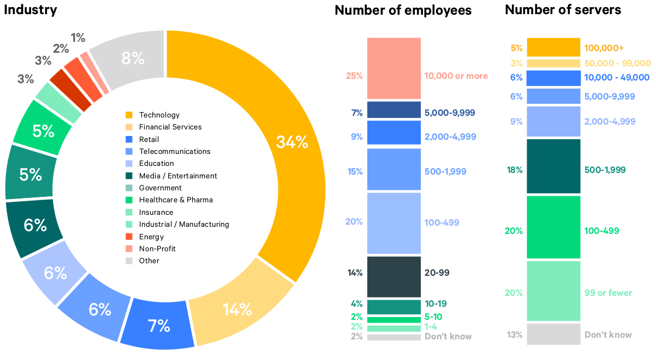
Industry state – ALM DevOps
Survey, which is conducted annually by Puppet, reached out to about 3200 people across the globe, including executives, developers, and IT professionals. The number of respondent who stated that they work on DevOps teams has increased from 16% to 27% in the last three years, indicating a rise in DevOps adoption
Puppet Releases - 2017 State of DevOps Report

Slide 4
Impact of ALM -DevOps
ORGANIZATIONS THAT HAVE IMPLEMENTED ALM - DEVOPS SAW THESE BENEFITS
IMPROVED QUALITY OF SOFTWARE DEPLOYMENTS
65%
MORE FREQUENT SOFTWARE RELEASES
63%
IMPROVED VISIBILITY INTO IT
PROCESS AND REQUIREMENTS
61%
CULTURAL CHANGE
COLLABORATION/COOPERATION
55%
MORE RESPONSIVENESS TO BUSINESS NEEDS
55%
MORE AGILE DEVELOPMENT
51%
MORE AGILE CHANGE MANAGEMENT PROCESS
45%
IMPROVED QUALITY OF CODE
38%

Slide 5

ALM-DevOps - Future trend

Slide 6


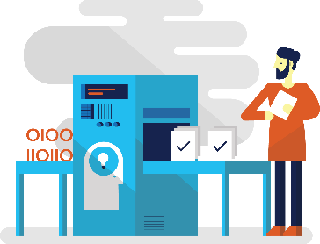


How ALM-DevOps helps Business
2
3
More Resilience
4
Faster Detection & Remediation
5
Accelerate delivery
Experimentation
1
Optimize resources
SLA

Slide 7

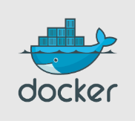
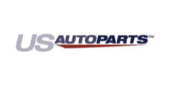






Cybage ALM - DevOps Facts
ALM/DevOps
80+
Experts
128
Implementations completed
48
Implementations in-progress
Partnerships
Clients

Slide 8
Cybage ALM - DevOps Maturity Model
Culture & Organization
Continuous Build
Environments
Release
Test & Validation
Information and Reporting
LEVEL 1
- Technology based Teams
LEVEL 2
- Standard tools & best practices
LEVEL 3
- Extended team collaboration
LEVEL 4
- Autonomous service teams for end-to-end NFR’s
LEVEL 5
- Documented process
- Adopt Agile methodology
- Define R&R for Dev & Ops
LEVEL 1
- Unit & Integration test into a CI process
LEVEL 2
- Build pipelines with automated tests
LEVEL 3
- CI Build breaks when SCA rules are broken
LEVEL 4
- Dev & CI Environment per component
LEVEL 5
- Story completed when service is deployed and used in production
- Test failure process
- Production readiness tests in CI process
- Dashboards of all test execution results
- Build Time Targets defined
LEVEL 1
- Minimal test environments
LEVEL 2
- Migrate to cloud
LEVEL 3
- Self Service provisioning
LEVEL 4
- Automated spin up and tear down environments
LEVEL 5
- Auto-scaling and provisioning of environments
- Engineers access to hosts and DBs
- Environment configuration as code in source control
- Integrated environment into deployment pipelines
- Automated tests to validate environment
LEVEL 1
-Manual Code Deployment, Installation & Configuration
LEVEL 2
- Deploy to any environment till production
LEVEL 3
- Automated and Triggered Deployment Tasks
LEVEL 4
- Automated Installation & configuration
LEVEL 5
- Automated Deployment with Zero Downtime
-Rollback Process
- Deployment scripts for environments
- Service installation
- Configuration scripts
- Automated rollback with validation
- Canary release process
LEVEL 1
- Manual deployment Testing
LEVEL 2
- Automated deployment validation using smoke tests
LEVEL 3
- Triggered automated tests
LEVEL 4
- AB Testing
LEVEL 5
- Chaos Monkey Testing
- Logging & monitoring dashboards
- Automated Smoke and Capacity tests with dashboards
LEVEL 1
- Baseline process metrics
LEVEL 2
- Measure the process
LEVEL 3
- Automatic generation of release notes
LEVEL 4
- Continuous deployments Auditing
LEVEL 5
- Dynamic customizable dashboards
- Manual reporting
- Automatic reporting
- Pipeline traceability
- Real time graphs on deployment pipeline metrics
- Cross reference across organizational boundaries
Build Verification Speed
Build Verification Frequency
Defect / Incident Volume
Build Lead Time
Build Interval Time
Transparency
Collaboration
Build Failure Rate
Build Fail Recovery Time
Deployment speed
Deployment Frequency
Requirement Coverage Ratio
Mean Time to Restore Service (MTTR)
Deployment Success rate

Slide 9
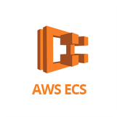


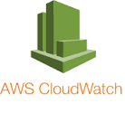
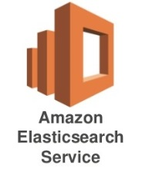
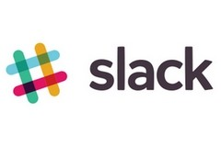
ShowCase – US AutoParts
Client Info
Legacy State
Cybage Solution
Practice: Online Retail
Business : Autoparts
Employees : 1100 approx.
Project Size : 80
Manual build, QA and deployment processes.
Quality gates & early feedback was missing
No bi directional traceability.
Manual environment creation.
Automated the CI/CD process
Infra as Code - Automated provisioning of all Environments
Dev, QA and Ops teams used the Same Docker image to create Environments
Using Orchestration service, we met NFR - HA, Auto scalability, Auto healing
Continuous monitoring of Hosts, Containers and Applications
Notes:
Client Information

Slide 10
ShowCase – US AutoParts
Impact
Performance Indicators
Level 1
Level 3
Maturity
Build Time
5 hrs.
1 hr.
App. Downtime
8 min
1 min
Requirement Coverage
0%
100%
Speed of Deployment
20 min
10 min
Culture & Organization
Continuous Build
Environments
3
Release
Test & Validation
Information & Reporting
5
3
3
3
2
Notes:
Client Information

Slide 11
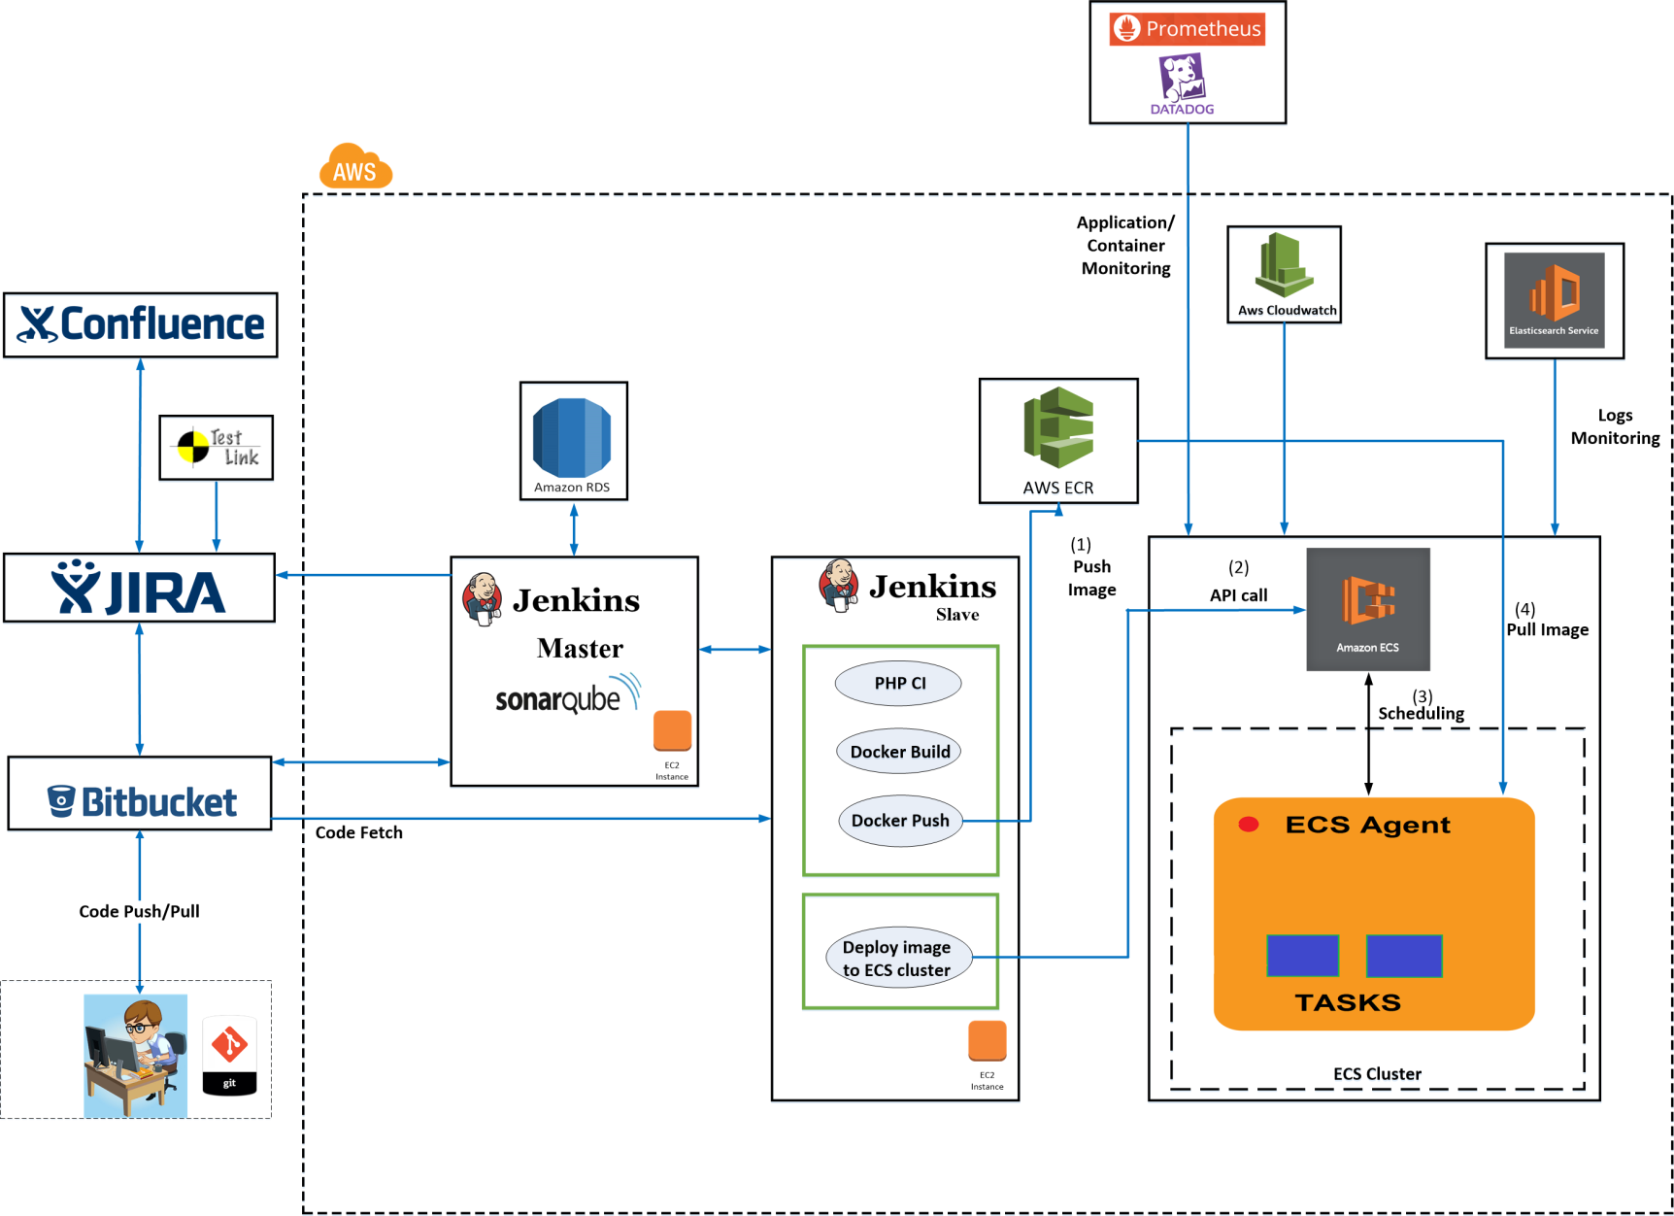
ShowCase – US AutoParts
11

Slide 12
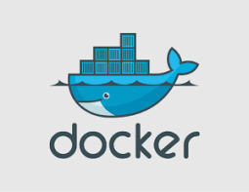
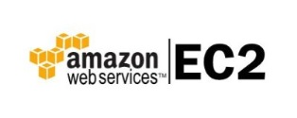




ShowCase – Nexant iEnergy
Client Info
Legacy State
Cybage Solution
Practice:
Business :
Employees :
Project Size :
Workflows not enforced while committing code to VCS.
Environments are not immutable
Environment provisioning is manual
No process to check code quality
Lack of build automation, all manual process
Lack of quality, visibility, governance, collaboration, process, traceability and reports.
Implemented Continuous Integration and Continuous delivery
Versioning artifacts in binary repository management tool
Environments are created using infrastructure as a code
Functional test cases execution is automated
Reports are generated and published on centralized server
Automated feedback mechanism on failed/passed build via mail
In case of any bug, it can be back tracked which war file and which code check in has introduced issue.

Slide 13
ShowCase – Nexant iEnergy
Impact
Immutable and identical environments reduce bugs in production by 40-60%
Feedback mechanism for every build provides early detection of issue
Level 1
Level 3
Maturity
Culture & Organization
Continuous Build
Environments
3
Release
Test & Validation
Information & Reporting
3
3
3
3
2
Build Time
8 hr.
1 hr.
No of Bugs (Release)
85
30

Slide 14
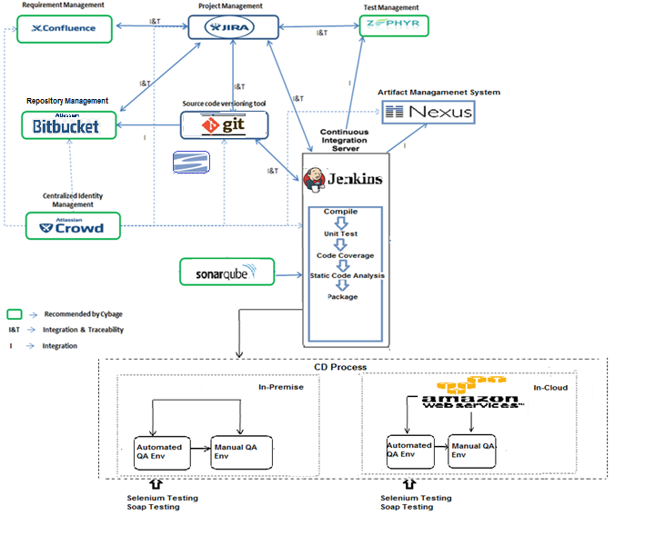
ShowCase – Nexant iEnergy : CI Architecture
14

Slide 15
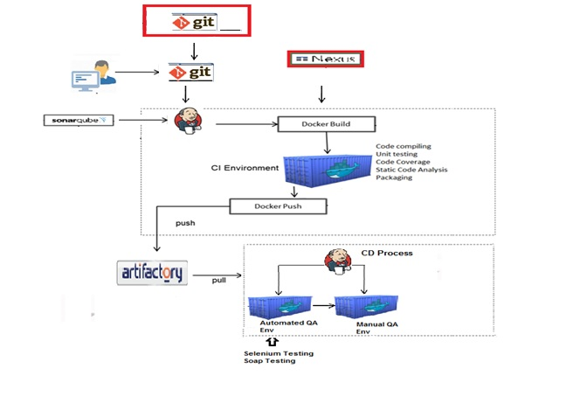
ShowCase – Nexant iEnergy : CD Architecture
15

Slide 16
ShowCase – Nexant iEnergy
Client Info
Legacy State
Cybage Solution
Practice:
Business :
Employees :
Project Size :
Workflows not enforced while committing code to VCS.
Environments are not immutable
Environment provisioning is manual
No process to check code quality
Lack of build automation, all manual process
Lack of quality, visibility, governance, collaboration, process, traceability and reports.
Implemented Continuous Integration and Continuous delivery
Versioning artifacts in binary repository management tool
Environments are created using infrastructure as a code
Functional test cases execution is automated
Reports are generated and published on centralized server
Automated feedback mechanism on failed/passed build via mail
In case of any bug, it can be back tracked which war file and which code check in has introduced issue.

Slide 17
ShowCase – MSCom
Legacy State
Cybage Solution
Impact
Requirement Management, task management, iteration planning were missing.
Since the requirements were gathered over email/call, it was difficult to keep a track of them.
No code versioning. Hence, difficult to maintain history.
Build, deployment, rollback/ backup and test case management were manual.
No Static Code Analysis.
Recommended TFS 2015 and Sharepoint for Requirement Management, task management, iteration planning and end to end traceability.
Reporting server recommended for enhancing visibility.
Configured TFVC system for code versioning, maintaining history and suggested branching and merging for isolating risk of changes.
Automated build, deployment, rollback/ backup (on azure) and test case.
Implemented SonarQube for code quality.
Maturity Level
Level 0
Level 3
Build Time
5 hr
1 hr
App. Downtime
8 min
1 min
Requirement Coverage
0%
100%
Speed of Deployment
50 min
30 min

Slide 18
Our services (ALM - DevOps)
Services
ASSESSMENT
ALM Audits
GAP Assessment of existing ALM Tool’s Practices
Implementation
Continuous Integration
Continuous Delivery / Deployment
Infrastructure as Code
Continuous Monitoring
Virtualization and containerization
On-premise and Cloud-based solutions : AWS/Azure
CONSULTANCY
Designing DevOps roadmap, framework and strategy
Defining unified DevOps Tools and process blueprint across the organization
Training
Atlassian Tools
Microsoft TFS and VSTS
DevOps Practices & Tools
18

Slide 19








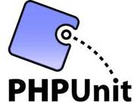
















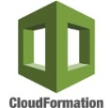


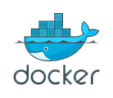
ALM Tools Integration (Open Source)
Requirements management
Project
management
Architecture & Design
Cloud provider
Development
Testing
Development
Development
Test case management
Unit
testing
SCM
SCA
Continuous Integration
or
or
Build
CI server
or
Artifactory
management
or
Repository management
or
ANT
or
or
or
&
or
or
Automation
testing
Continuous Delivery/Deployment using DevOps
Configuration management
Containerization
Continuous Monitoring
or
or
ELK
Sysdig
cadvisor
Note: Solution offering for on-premise & on-cloud
19

Slide 20

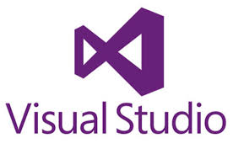

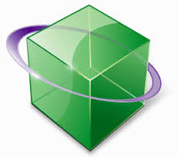




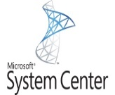


ALM Tools Integration (Microsoft)
Requirement Management
Project
Management
Architecture & Design
Cloud provider
Architecture & Design
Development
Testing
Unit
testing
SCM
SCA
Microsoft Test Manager
Continuous Integration
or
Build
CI server
or
or
MS Build
Automation
testing
or
or
or
Coded UI Test
Repository management
or
or
ANT
or
Continuous Delivery/Deployment using DevOps
Release
management
Configuration management
Containerization
Continuous Monitoring
or
Note: Solution offering for on-premise & on-cloud
20

Slide 21
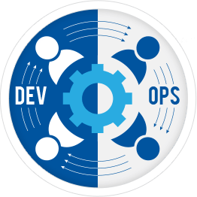
DevOps Ecosystem – Open Source
Provisioning
Cloud Provisioning
Virtualization
Load-Balancer
Chef
Puppet
Ansible
Terraform
Cloud Formation
Docker
Nginx
HAProxy
Orchestration
Cloud Providers
Kubernetes
AWS ECS
Swarm
AWS
Azure
Docker OS
CoreOS
Alerts
Service discovery
Continuous monitoring
Data Persistence
Pagerduty
CloudWatch by AWS
Consul
Etcd
Eureka
ELK
Sysdig
Ruxit
Nagios
Flocker
21

Slide 22
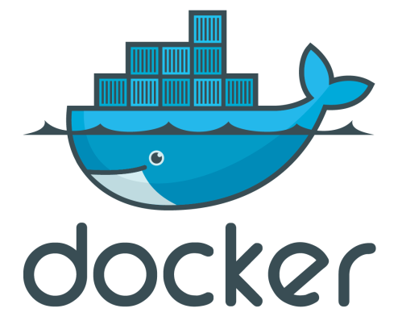
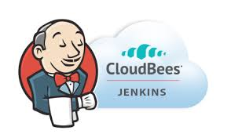


Docker Ecosystem for DevOps
Docker Tools
Orchestration
Image Scanning
Deployment
Compose
Swarm
Kubernetes
Mesos DC/OS
Swarm
Twistlock
Spinnaker
Jenkins
Registry
Docker on Cloud
Docker Hub
AWS ECR
Private Registry
AWS ECS
Azure ACS
Docker OS
CoreOS
RancherOS
Networking
Service Discovery
Monitoring
Stateful
Weave
Calico
Consul
etcd
Eureka
Sysdig
Datadog
Prometheus
Ceph
AWS EFS
Convoy
Competency in Cloud Based CI/CD Providers with Docker Support
22

Slide 23
Cybage Approach for Implementation
Ownership: The ALM team
Ownership : Support Team
ALM
Awareness
ALM
Gap Assessment
ALM
Solution Proposal
ALM
Implementation
Post-implementation Support
ALM presentation
ALM demo for stakeholders
Understand the workflow
Analyze gaps
Identify R&D or POC
Propose end-to-end solution with integration
Implementation
Training
Handholding
Sign-off
Audits (later)
Reports compilation
Support
23

Slide 24
Thank you!

